Slide 1
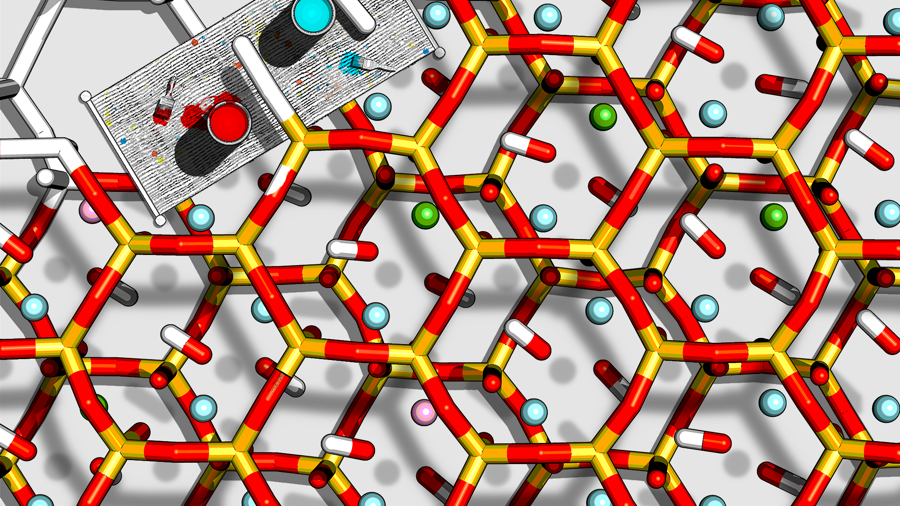
Computational Techniques in Chemistry
Session 4:
Projects
Valentina Erastova University of Edinburgh
January 2025
Big thanks to Matteo Degiacomi (matteo.degiacomi@ed.ac.uk) and Hannah Pollak (h.pollak@sms.ed.ac.uk for material development

Slide 2
Course organisation
Monday/Tuesday
Thursday/Friday
Week 1
Introduction to Linux and command-line
Workshop
Drop-in
Week 2
Introduction to molecular dynamics simulations
Workshop
Drop-in
Week 3
Molecular simulation set up of system with an interface or a protein system
Workshop
Drop-in
Week 4
Beginning of the individual projects
Workshop
Drop-in
Week 5
Drop-in
Project Submission

Slide 3
Projects
30% of the Research Techniques Course
Each project is unique – you will get your project today
The project is similar to the work in Session 3
You must carry out your project work independently

Slide 4
Use of AI
Allowed, but must be declared:
What tool has been used (e.g., University-licenced ELM ← recommended);
What was the exact prompt;
Link to the output (‘link to chat’ for ChatGpT) or a compilation of outputs as an appendix;
What modifications have been done to the generated output before it was incorporated into the submitted work.
Undeclared use of AI will be flagged as misconduct and treated as plagiarism.

Slide 5
Project Report Structure
Abstract
Up to 150 words
concise summary of your work
understandable as a standalone piece
Methods
~500 words
all key steps to prepare, run and analyse the simulation
another scientist must be able to repeat your work
Conclusions
~100 words
key conclusions from your study
Introduction
Up to 150 words
motivation for your work
Results & Discussion
~500 words
your data
plots, renderings, tables to support your observations
small discussion
Bibliography
use Mendeley/Endnote/.bib

Slide 6
Project Report Structure
Abstract
Up to 150 words
concise summary of your work
understandable as a standalone piece
Methods
~500 words
all key steps to prepare, run and analyse the simulation
another scientist must be able to repeat your work
Conclusions
~100 words
key conclusions from your study
System Setup
structures
how you assembled the system
force fields
Simulation Protocol
energy minimisation, equilibration, and production runs
time step and duration
temperature, pressure
Analysis
checks for equilibration
what part of trajectory used
analysis
software used
how did you plot and render
What were your observations?
Support them with figures (renderings, plots) and tables.
Captions need to be descriptive, so no need to read the main text.
Don’t forget to state what color is what atom.
Discuss the findings and compare to the literature.
Introduction
Up to 150 words
motivation for your work
Results & Discussion
~500 words
your data
plots, renderings, tables to support your observations
small discussion
Bibliography
use Mendeley/Endnote/.bib

Slide 7
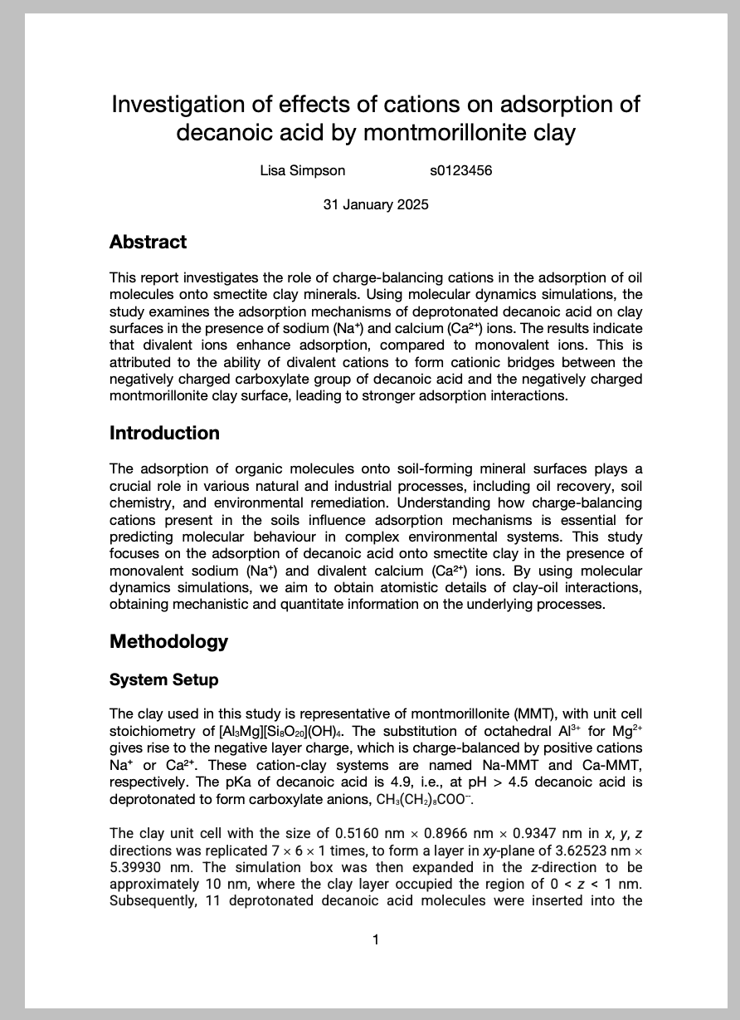
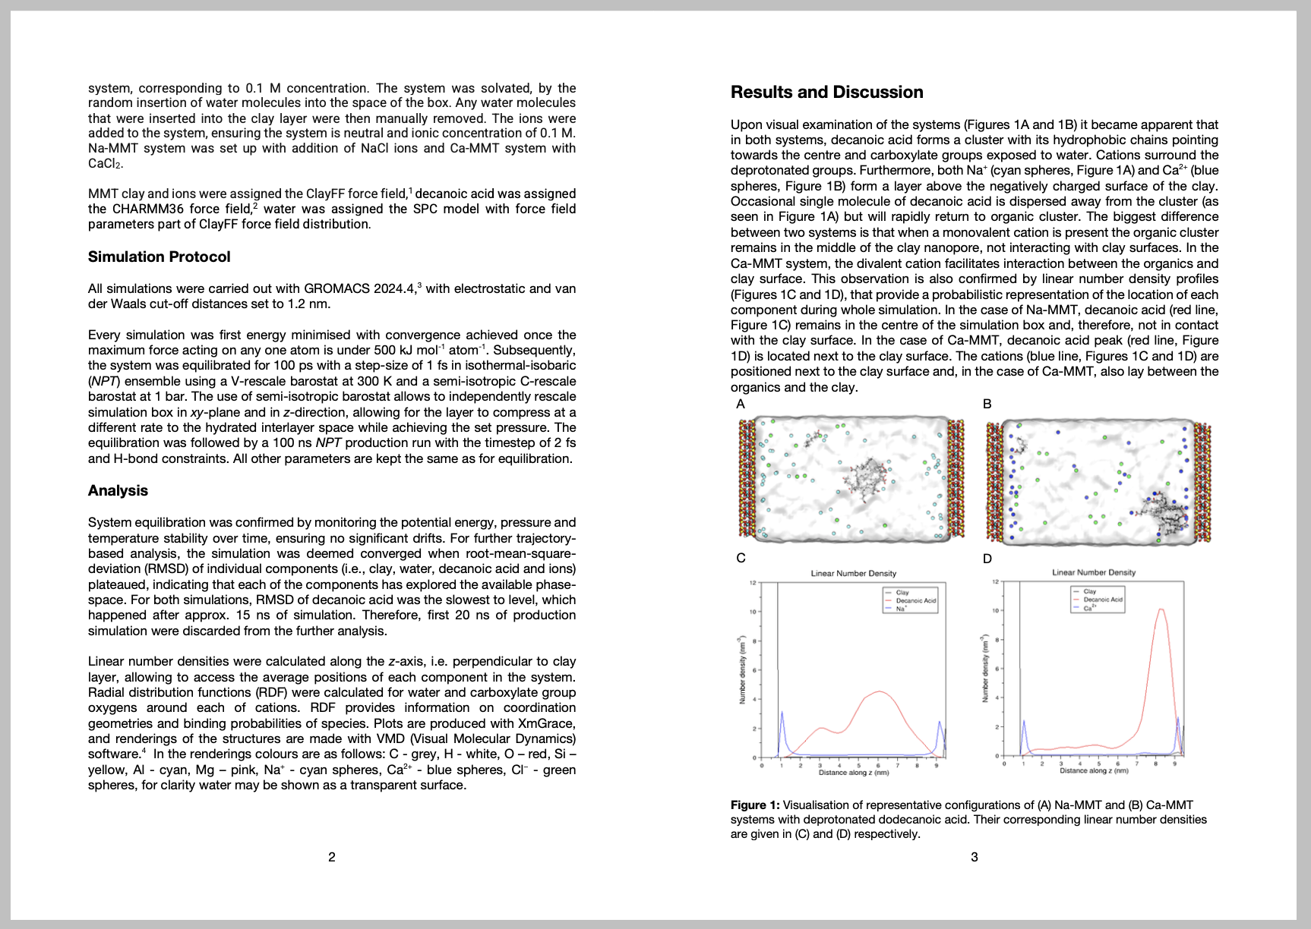
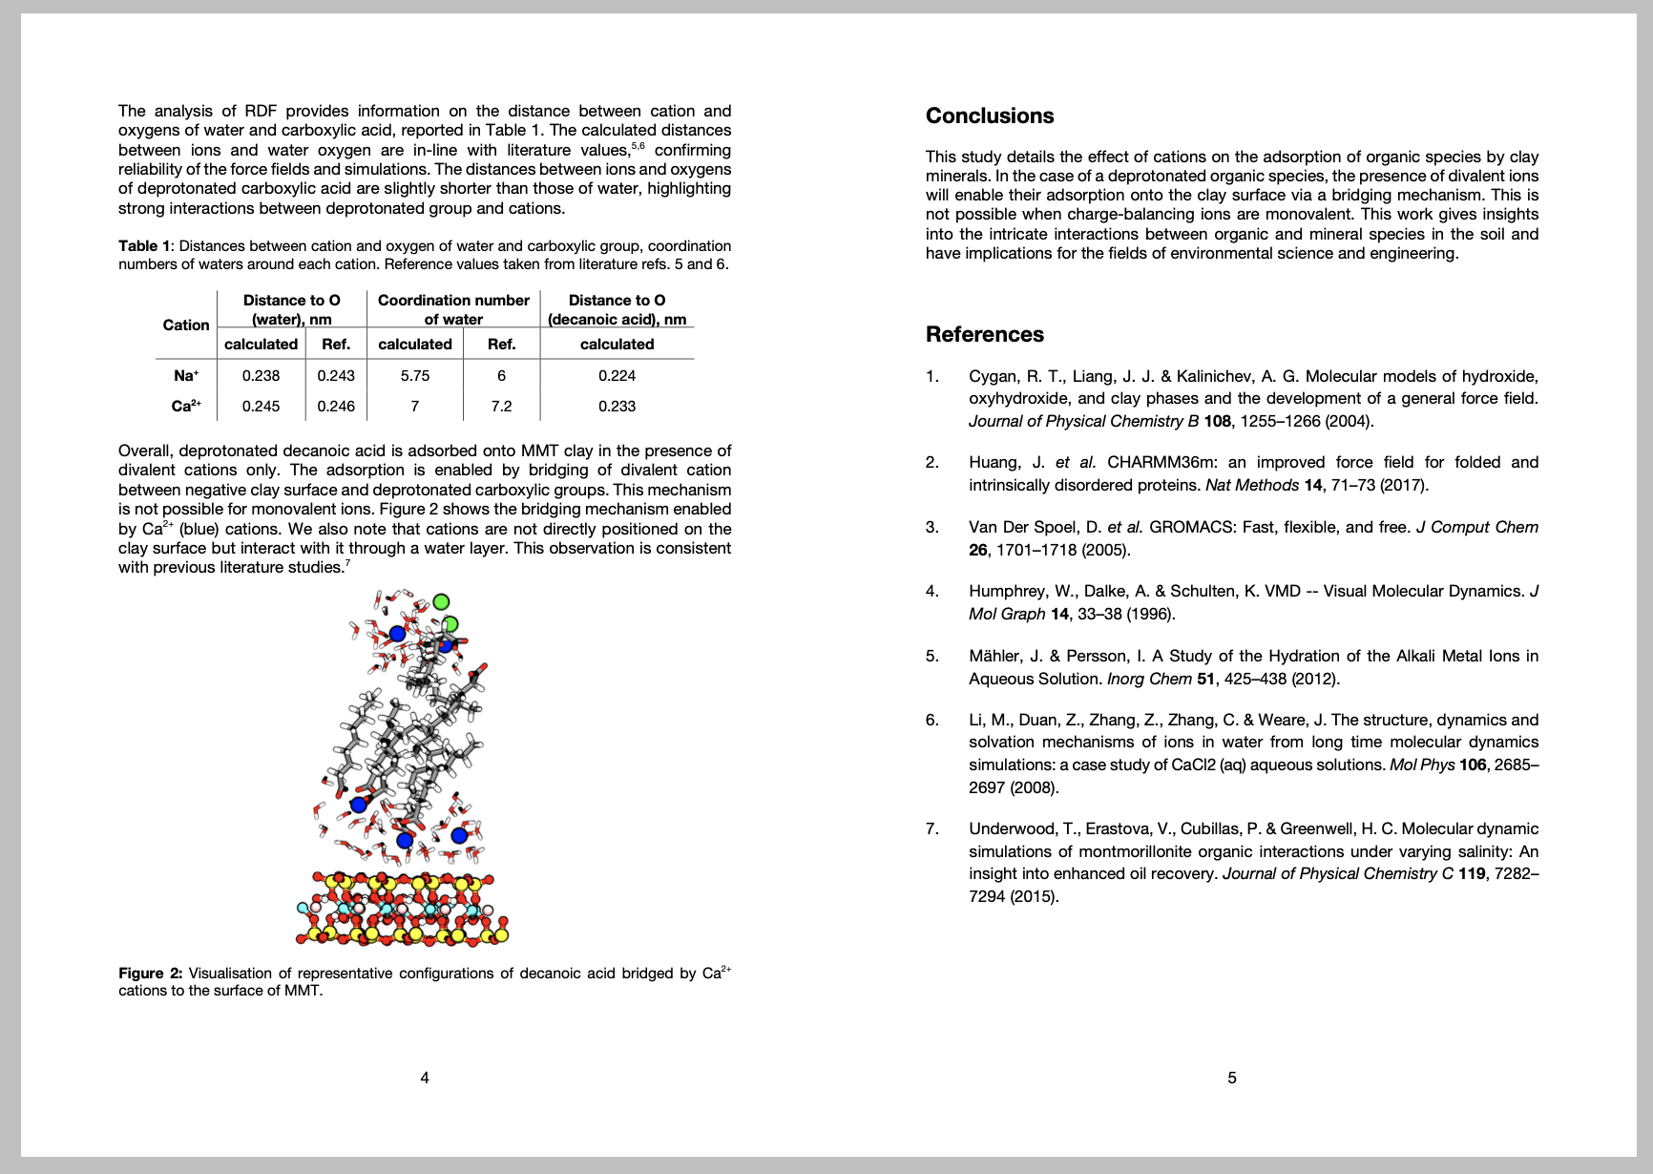
Example report

Slide 8
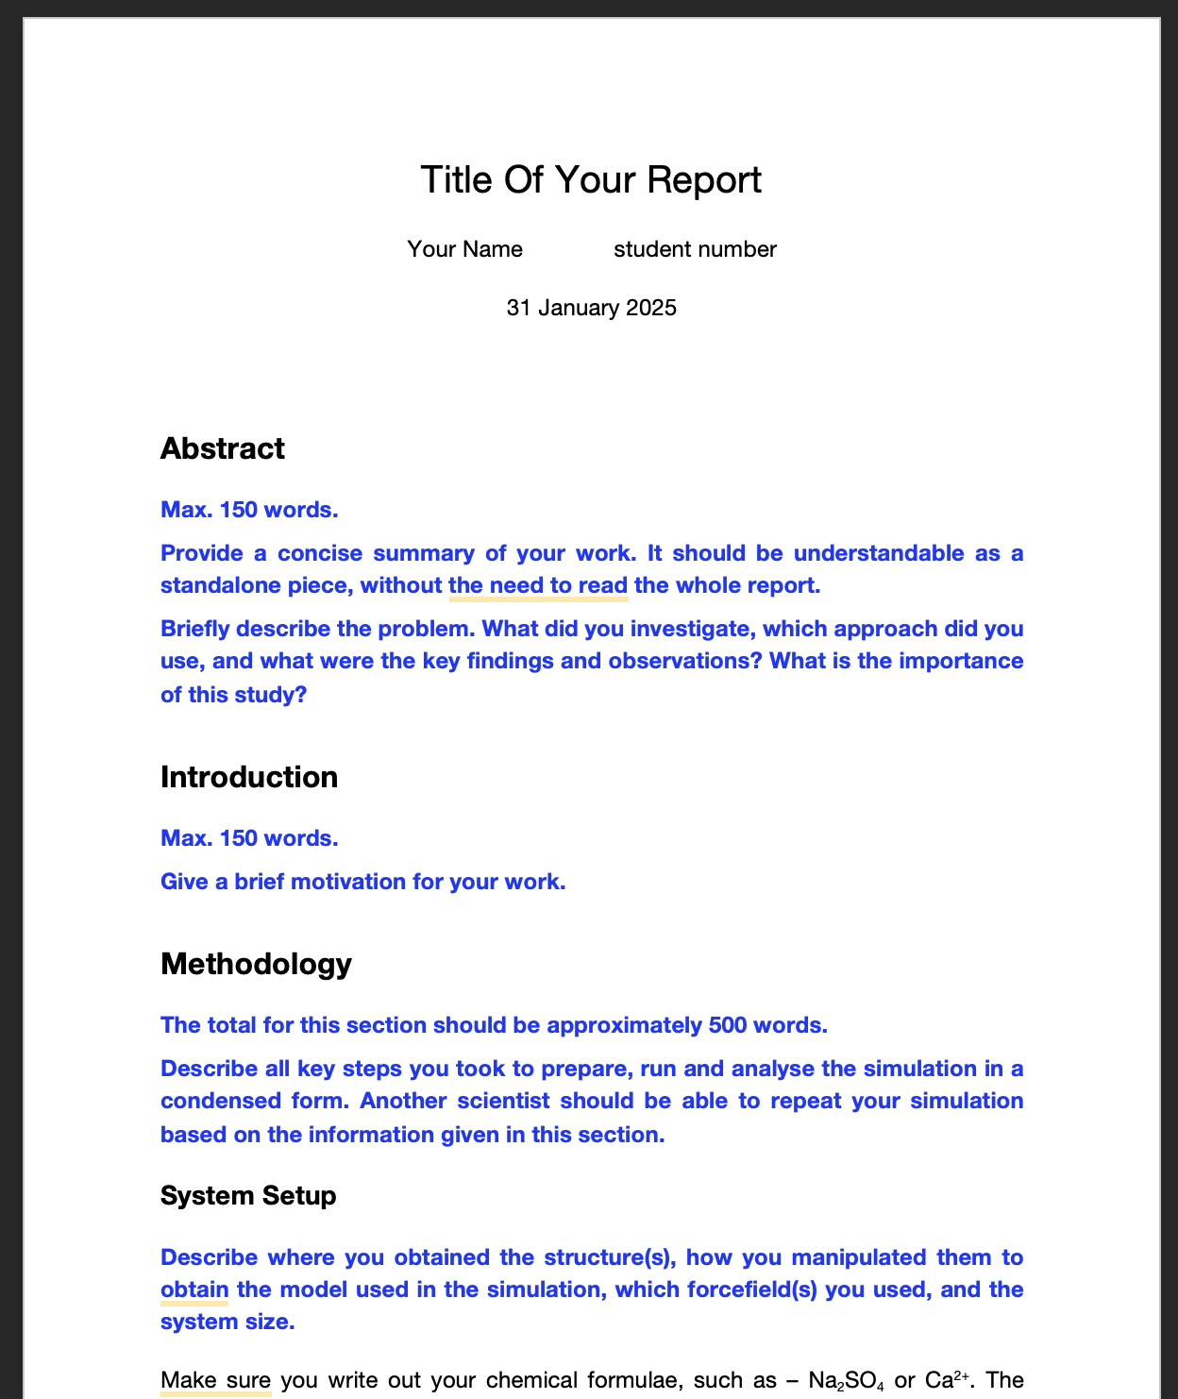
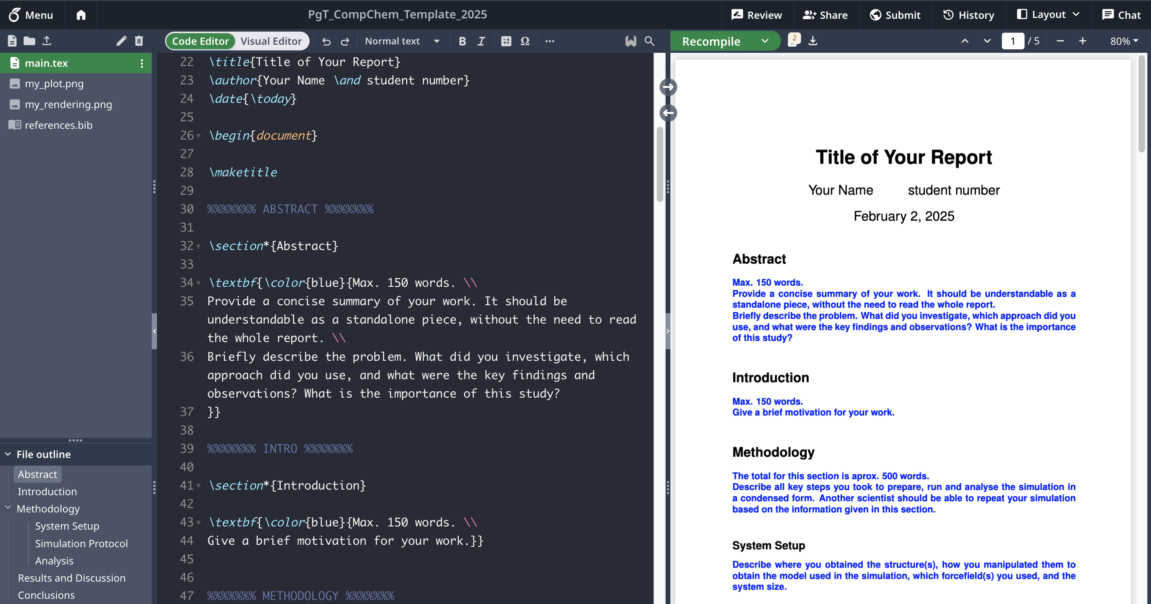
Templates
Word .doc
OverLeaf – LaTeX format

Slide 9

FEEDBACK PLEASE!
qrcode
1 – go to wooclap.com
2 – event code XREESD

